Slide 1
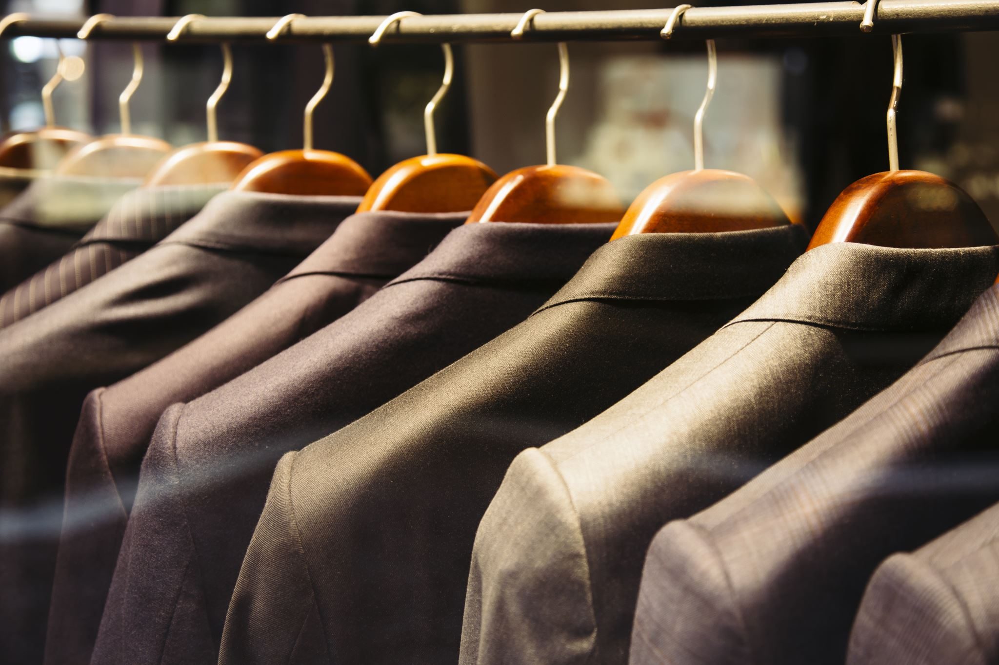

Fashion Recommendation System
DSCI-6011-04
Professor: Mohamad Nassar
Team Members:
Shashank Madipelly
Vedanth Reddy Doddannagari
Manichandra Domala
Sai Gowtham Reddy Gurrala

Slide 2
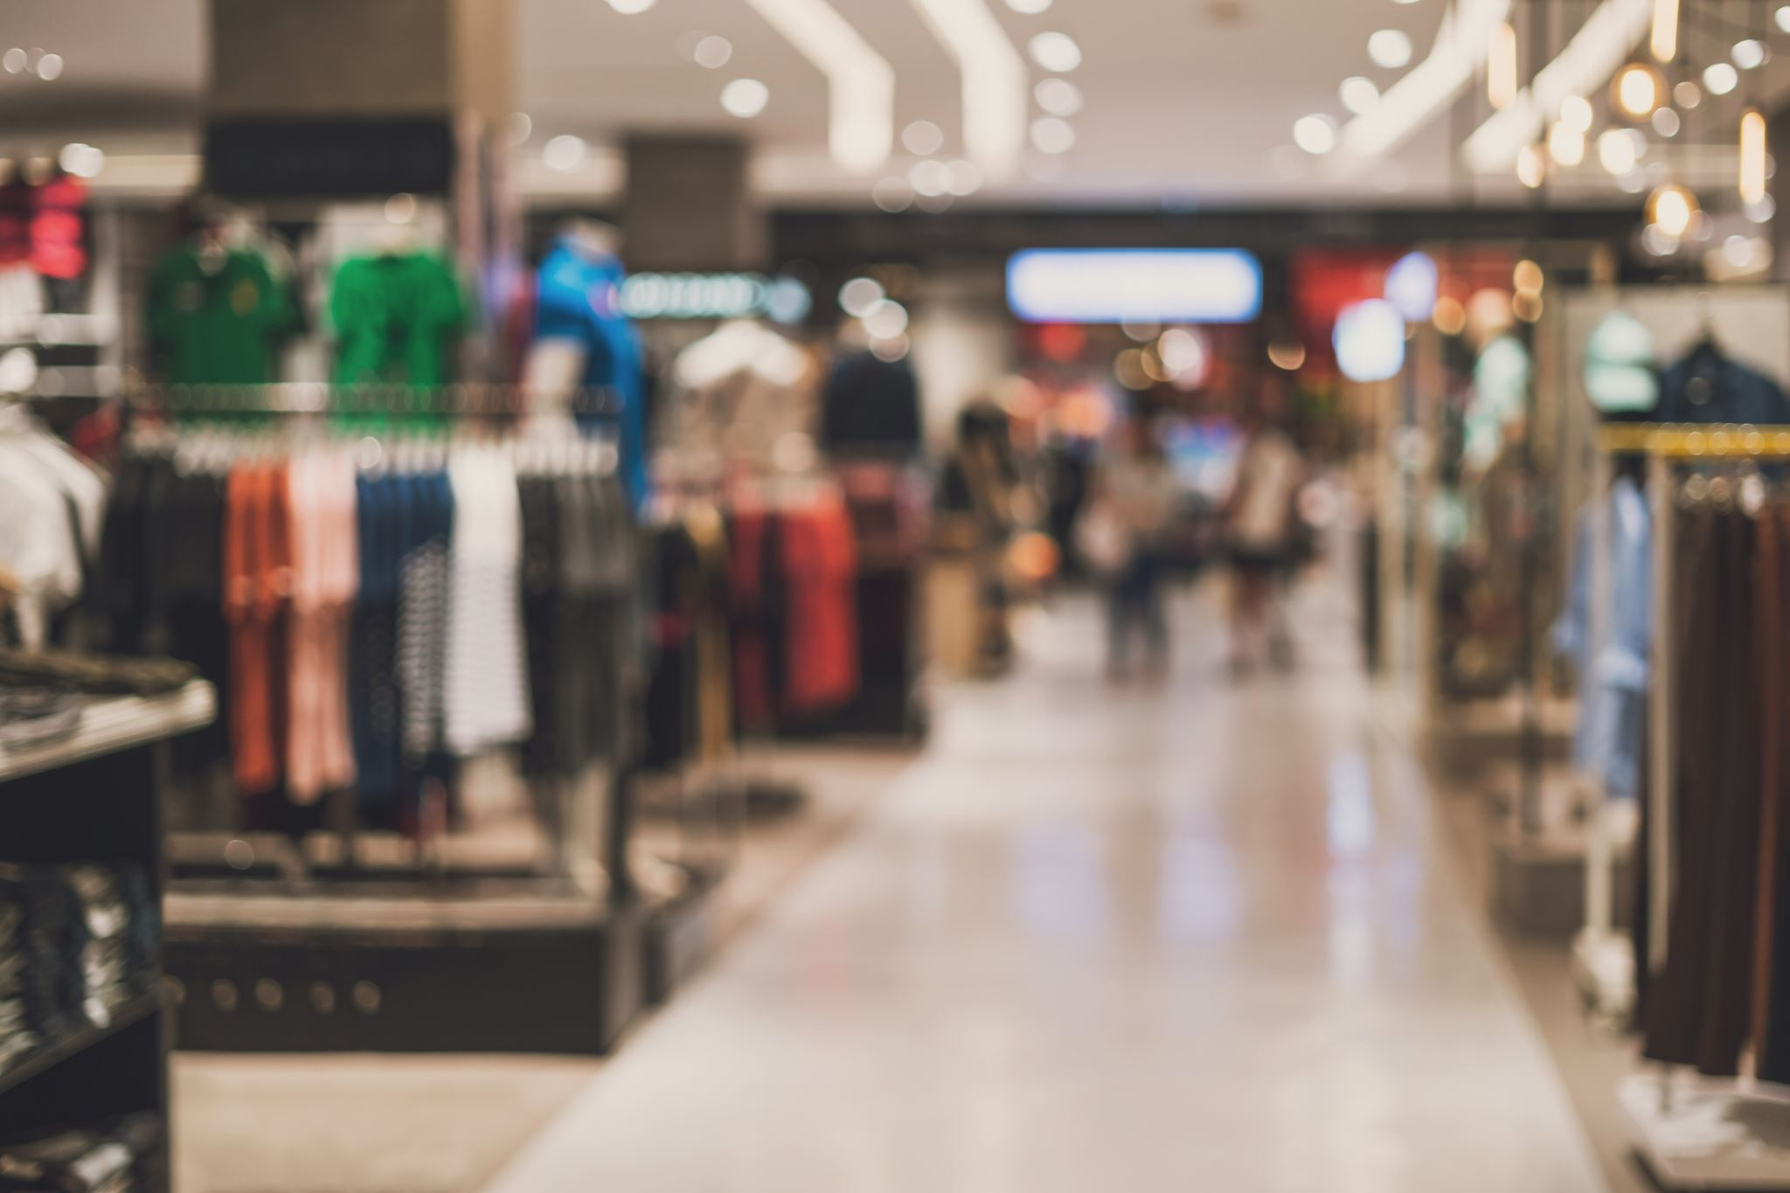
Introduction
Problem Statement:
The rapid growth of e-commerce has created an overwhelming choice for online shoppers, making it difficult for users to find products that match their personal preferences. This lack of personalization often results in reduced user satisfaction and lower conversion rates for retailers.
Goal:
Develop a personalized fashion recommendation system that enhances the shopping experience by suggesting products tailored to individual user preferences.

Slide 3
Project Scope
Key Objectives:
Build a Fashion Item Classification Model using CNN.
Develop a Recommendation Engine for personalized shopping experiences.
Use user-specific data for enhanced personalization.
Dataset:
Fashion Product Images Dataset.

Slide 4
Dataset Details
Dataset Used: Fashion Product Images
Contents:
44.4k high-resolution images across various fashion categories.
Categories include shirts, dresses, shoes, jackets, accessories and many more.
Multiple label attributes entered manually during cataloging.
Descriptive text commenting on product characteristics.
Key Features:
Provides a diverse and rich set of labeled images.
Enables detailed analysis and classification of fashion items.

Slide 5

Proposed Solution
Two-Part System:
1. Classification Model: We evaluated two deep learning architectures for the fashion item classification task:
ResNet50: A robust CNN with residual connections, well-suited for extracting features from high-resolution images.
EfficientNetB7: A state-of-the-art model balancing high accuracy and computational efficiency, leveraging compound scaling for better performance.
2. Recommendation Engine: Content-based system leveraging feature embeddings from the classifier.

Slide 6
Methodology
1. Data Preparation:
Use the Fashion Product Images dataset.
Data augmentation for model generalization.
2. Model Development:
Trained two CNNs: ResNet50 and EfficientNetB7.
Both models used pre-trained weights for transfer learning.
Feature embeddings extracted from the penultimate layer of each model were used for the recommendation engine.
3. Recommendation System:
Employ Nearest Neighbors for finding similar products.
4. Deployment:
Streamlit app for real-time recommendations and user feedback.

Slide 7
Technical Workflow
Image Upload: User uploads an image.
1
Feature Extraction: Use ResNet50 to extract image features.
2
Nearest Neighbors Search: Find similar products in the dataset.
3
Feedback Mechanism: Allow users to rate recommendations.
4

Slide 8
Implementation
ResNet50 and EfficientNetB7 for feature extraction.
NearestNeighbors for similarity search.
Streamlit for UI and feedback collection.
Feedback Storage
Ratings and comments are stored in a CSV file for analysis.

Slide 9
Results and Comparison
Model | Accuracy (%)
ResNet50 | 71.67 (Higher Accuracy)
EfficientNetB7 | 61.67%
Observations:
ResNet50 demonstrated higher accuracy, making it more suitable for the feature extraction.
While EfficientNetB7 is computationally efficient for scaling, it did not outperform ResNet50 in terms of accuracy in our project.

Slide 10
User Interface
Streamlit Application:
Upload images for recommendations.
View suggested products.
Provide ratings and comments for feedback.

Slide 11
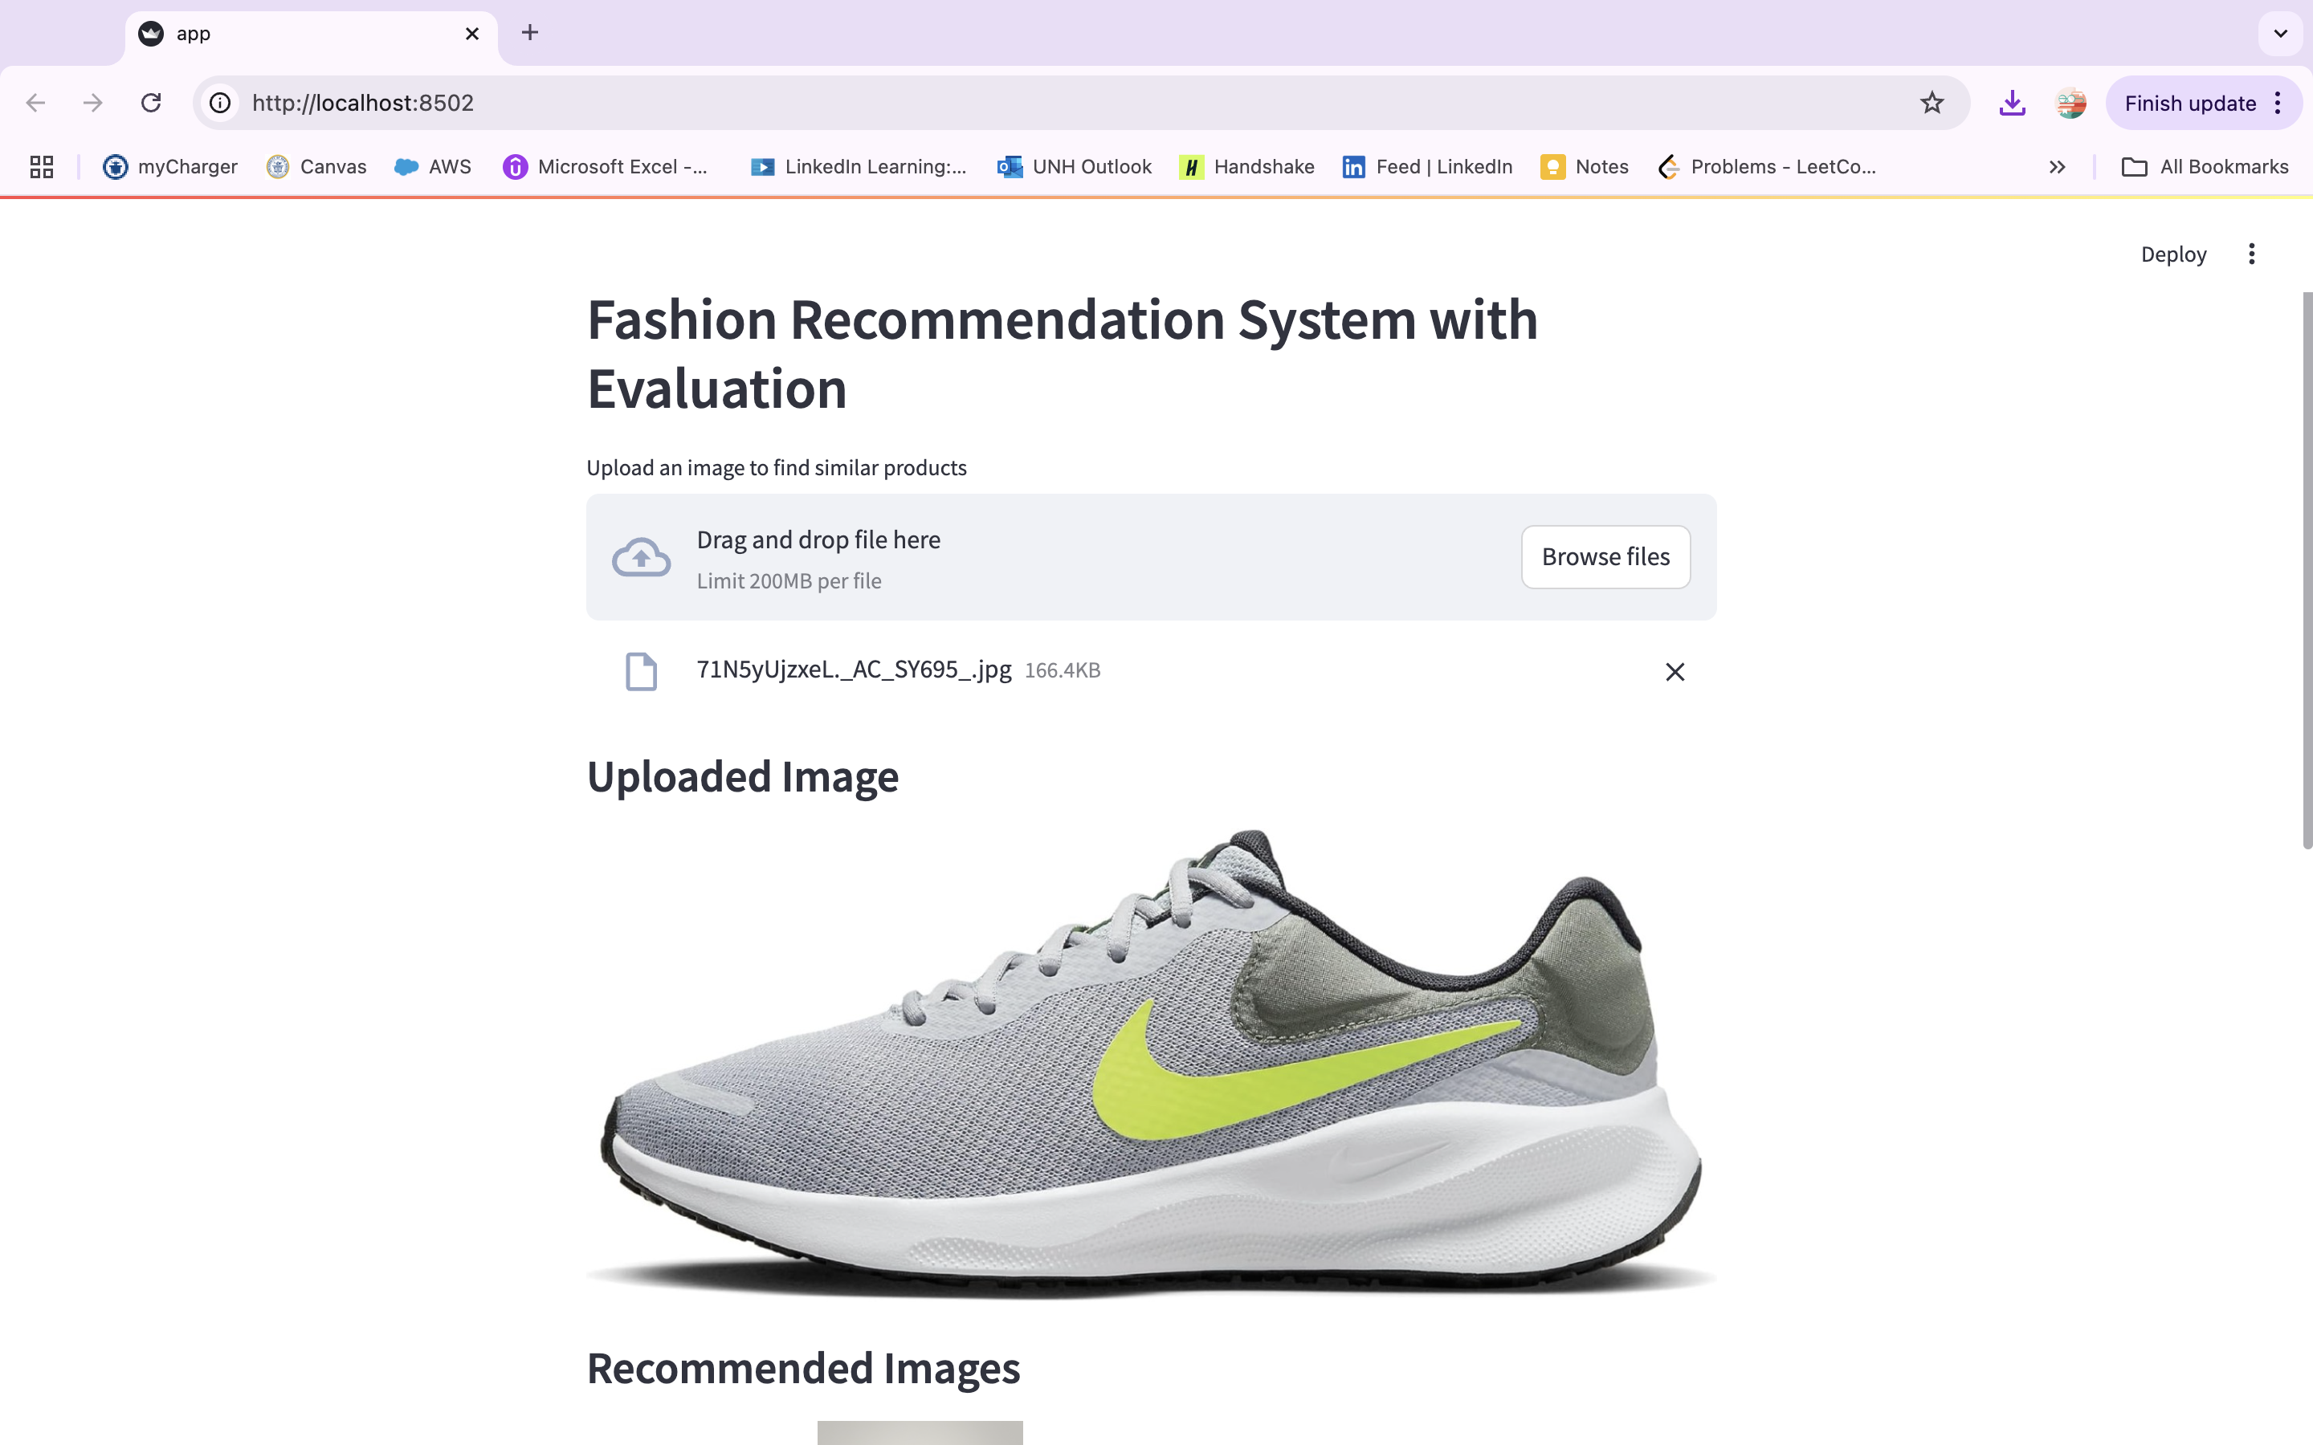
User Interface

Slide 12
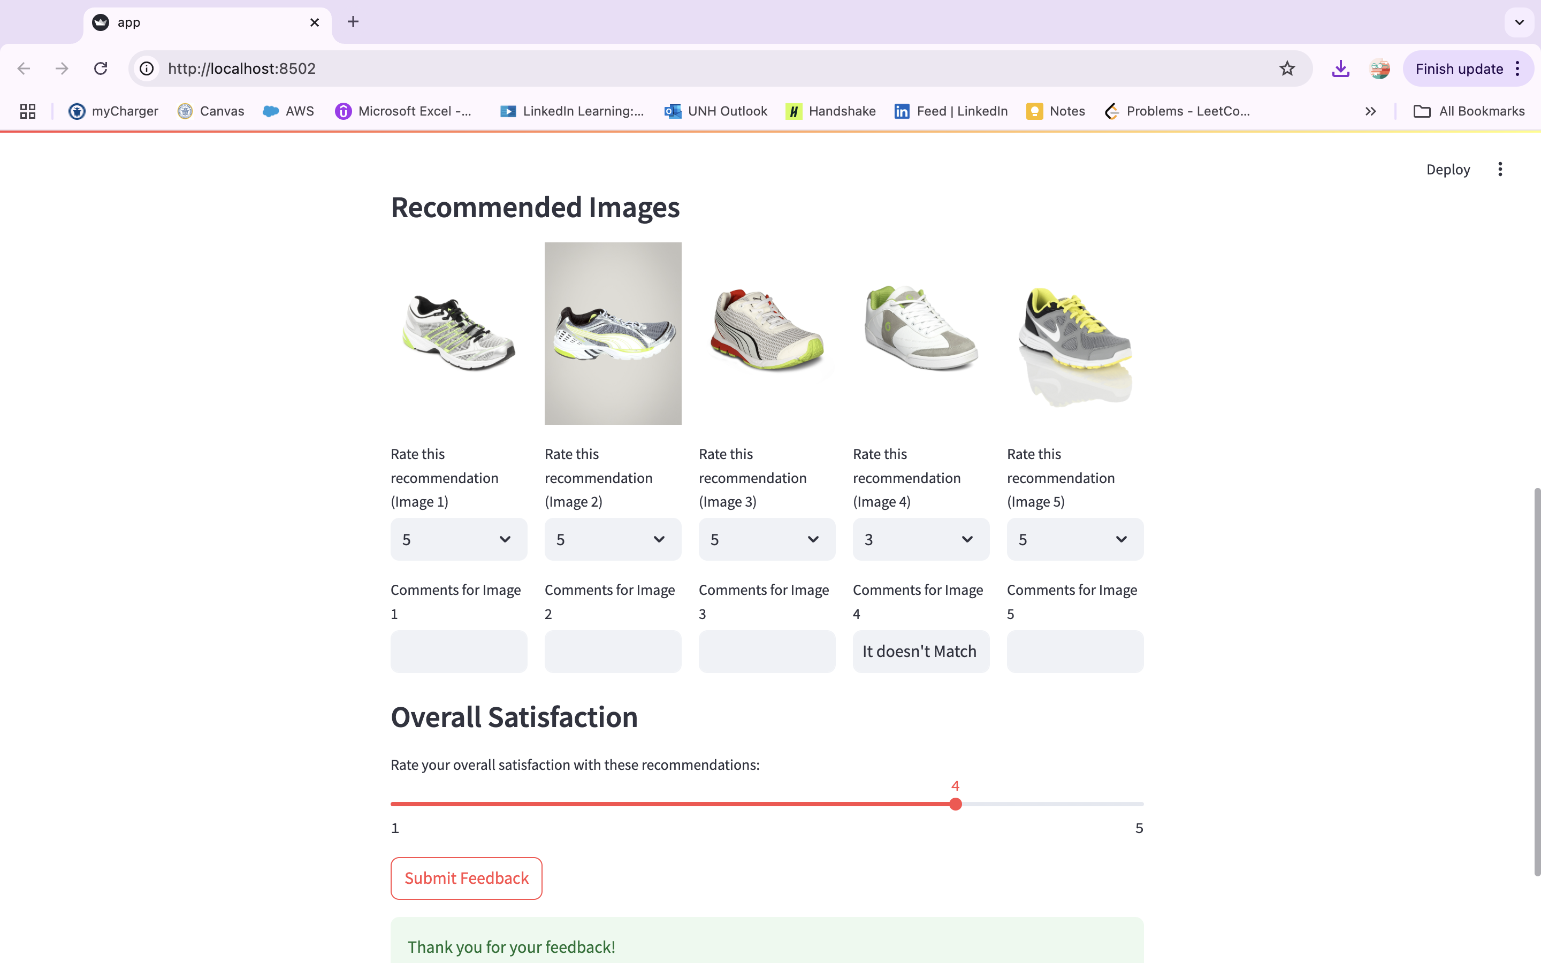
User Interface

Slide 13
Conclusion
Summary:
A personalized recommendation system can transform online shopping experiences.
Deep learning and content-based techniques improve user satisfaction and retailer profits.
Future Work:
Incorporate user purchase history for hybrid recommendations.
Extend to include collaborative filtering.

Slide 14

Thank You
We appreciate your time and attention!

